Slide 1
Chapter 11:
Inheritance and Composition:
Part I

Slide 2
Introduction
Two common ways to relate two classes in a meaningful way are:
  Composition, or aggregation: (“has-a” relationship)
  Inheritance (“is-a” relationship)
C++ Programming: From Problem Analysis to Program Design, Seventh Edition

Slide 3
Composition
C++ Programming: From Problem Analysis to Program Design, Seventh Edition

Slide 4
Composition (Aggregation)
In composition, one or more member(s) of a class are objects of another class type
Composition (aggregation): “has-a” relation
  Composition is a strong relationship (e.g., University and Departments
  Aggregation is a weak relationship (Department and Instructors)
C++ Programming: From Problem Analysis to Program Design, Seventh Edition

Slide 5
Composition (Aggregation)
Arguments to the constructor of a member-object are specified in the heading part of the definition of the constructor
Member-objects of a class are constructed in the order they are declared
  Not in the order listed in the constructor’s member initialization list
C++ Programming: From Problem Analysis to Program Design, Seventh Edition

Slide 6
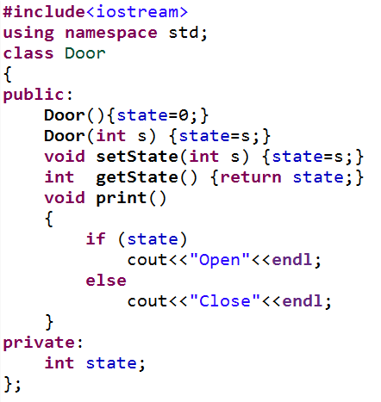
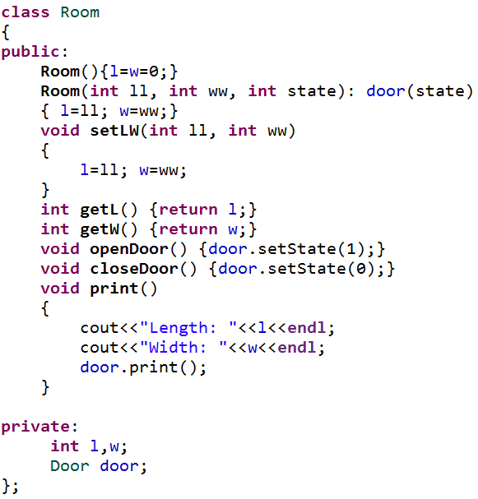
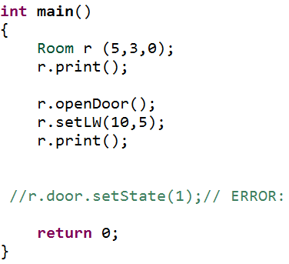
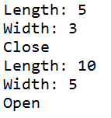
Composition (Aggregation)
OUTPUT
C++ Programming: From Problem Analysis to Program Design, Seventh Edition

Slide 7
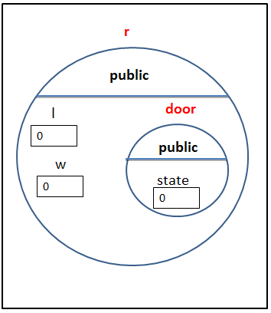
Order of Construction and Destruction
They are constructed before the containing class objects are constructed
The order of destruction is the opposite order of construction
C++ Programming: From Problem Analysis to Program Design, Seventh Edition

Slide 8
Composition & Default Constructor
If you do not initialize a member object in the member initializer list of the constructor ( or if the constructor is a compiler-generated constructor), the compiler will automatically invoke the member object’s default constructor
If the member object’s default constructor is missed and other constructors are available, an error will result
C++ Programming: From Problem Analysis to Program Design, Seventh Edition

Slide 9
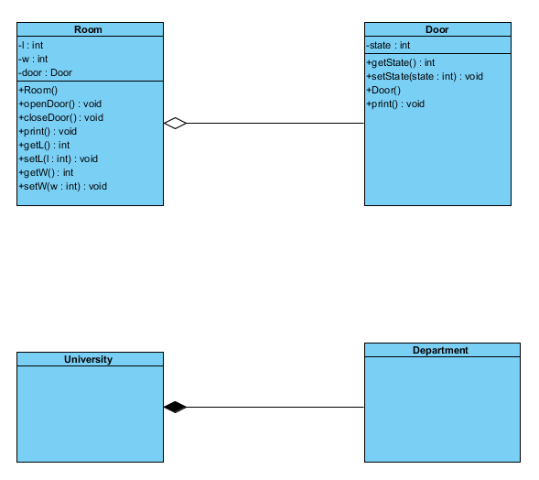
Graphical Representation of Composition & Aggregation
Aggregation
Composition
C++ Programming: From Problem Analysis to Program Design, Seventh Edition

Slide 10
Summary
In composition (aggregation):
  Class member is an object of another class
  Call to constructor of member objects is specified in heading of the definition of class’s constructor
C++ Programming: From Problem Analysis to Program Design, Seventh Edition

